Slide 1
Statistics-1 (STS-1)
Basics for Continuous Distributions
Normal Distributions

Slide 2
Agenda
Need for Continuous Distributions
Uniform Distribution
Key differences between Discrete and Continuous Distributions
Normal Distribution
Standard Normal Distribution
Z
Probability Density Function

Slide 3
Basics
Random experiment
Define, repeatable steps
Outcomes are elements of Sample space S
Sample space S
Discrete sample space
Continuous sample space
Random Variable
Is a numeric transformation of the outcome

Slide 4
Kambala Usain Bolt
Race timings are measured using devices available to organizers
The measurements can be at various levels of accuracy
We can measure timings in minutes and seconds
Or we can measure in milliseconds
As the measurement accuracy increases, the # of values in any interval increases
If we get down to millisecond accuracy the # of values increases manifold compared to measuring at seconds level
What if we have unlimited accuracy?

Slide 5
# of entries in interval can be very high
Marks of students in an exam
Assuming ¼ mark is the level of precision followed
So in a 100 marks paper there can be 401 unique marks students can score
Exact incomes per month of every Indian
Can be any number with 2 decimals between say 10K to several hundred Crs
Weights of students in a country
Can be measured in Kgs to milligrams
Tracking location of a satellite in space
Consider the length of orbit, consider delay in tracking signal from base station to satellite and back
Time of arrival of a train scheduled to arrive at 9AM
Measured in seconds accuracy, if train reaches within 15 min of 9 AM we can see 15 * 60 unique values

Slide 6
Visualize the distribution of Discrete RV, Continuous RV
Marks in a class test for 5 marks
Class of 20 people
Marks in a class test for 5 marks
marks not rounded up
Mark | Frequency | Probability
0 | 0 | 0/20
1 | 0 | 0/20
2 | 0 | 0/20
3 | 4 | 4/20
4 | 13 | 13/20
5 | 3 | 3/20
 | 20
Mark | Frequency | Probability
0 | 0 | 0/20
0.5 | 0 | 0/20
1 | 0 | 0/20
1.5 | 0 | 0/20
2 | 0 | 0/20
2.5 | 1 | 1/20
3 | 3 | 3/20
3.5 | 6 | 6/10
4 | 7 | 7/20
4.5 | 2 | 2/20
5 | 1 | 1/20
 | 20

Slide 7
Probability distribution
Discrete RV
Continuous RV
Each possible value the RV can hold versus Probability of that value
Each possible value the RV can hold versus Probability density
Area under the curve is probability

Slide 8
Are individual values in a Continuous Distribution important?

Slide 9
Are individual values in a Continuous Distribution important?
We are interested in a range and not in individual values

Slide 10
Continuous Random Variable
As precision increased the # of unique values in an interval increase
The probability associated with each value is lower
However, the total probability of a distribution should still be 1.

Slide 11
Representing Probability of CRV
Within a given interval, a CRV can take any value i.e. there are infinite values or uncountable # of values
In case of Discrete RV, for each the probability was represented as the height of bars
In Continuous RV probability is represented as area under the curve
In Binomial and Poisson Plots, the dots are not connected with a line
Because the data belongs to a discrete distribution

Slide 12
Continuous Distributions
Distribution, implies Probability Distribution of a Random Variable i.e. the values a random variable can hold and their probabilities
Continuous Distributions depict the probabilities associated with all the values a CRV can hold
Probability Density Function connects each value of RV to the corresponding Probability Density
For Discrete Random Variable it is called Probability Mass Function

Slide 13
Probability Density Function f(x)
The f(x) >= 0 for all x
For a<= x <= b, the area under the curve for f(x) gives the probability of p[a<= x <= b]
As the sample space associated with the experiment is continuous there are infinite values possible.
The probability associated with an individual value hence shrinks (to zero)
Sum of probabilities associated with all the values is 1.
So for CRV, probabilities is measured in an interval and not for specific x

Slide 14
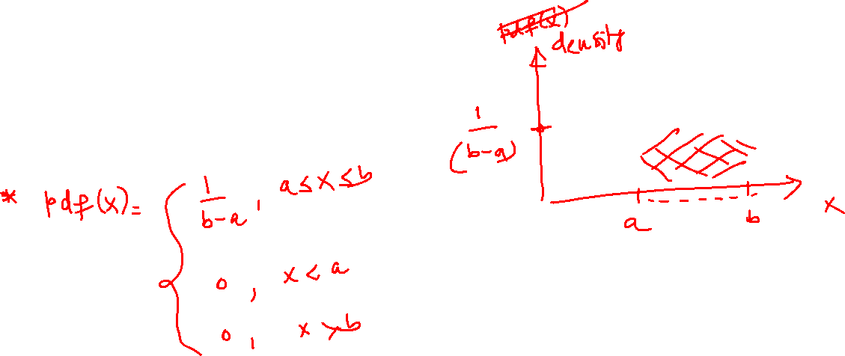

Uniform Distribution
Notation U(a,b)
Also called Rectangular Distribution
X ~ U(a,b)

Slide 15
We saw some Discrete Uniform Distributions
1] Coin landing on Heads or Tail
2] Drawing a card from a pack of cards
3] Single die roll
1/6
Single Die Roll
Probability Mass Function
1
2
3
4
5
6
Now we are going to see Continuous Uniform Distributions

Slide 16
Examples of Continuous Uniform Distributions
A scale has cm and mm markings, used to measure lengths. The error in measurement is between -0.5 to 0.5 uniformly
Pseudo Random number generator, equal frequency of numbers in the set range
Location of a puncture in a tyre (i.e. all points are equally likely)

Slide 17
Uniform Distribution
This when represented as a graph has a rectangular shape
The probability function or probability density function is:
f[X] = 1/(b-a), a<= x <= b, = 0, for all other x
Why is the height 1/(b-a)?
Area under the probability function must be equal to 1
Since the width is (b-a), height is 1/(b-a)
Notation: U(a, b) stands for Uniform Distribution in [a, b]
f[x]
1 / (b-a)
x
a
b

Slide 18
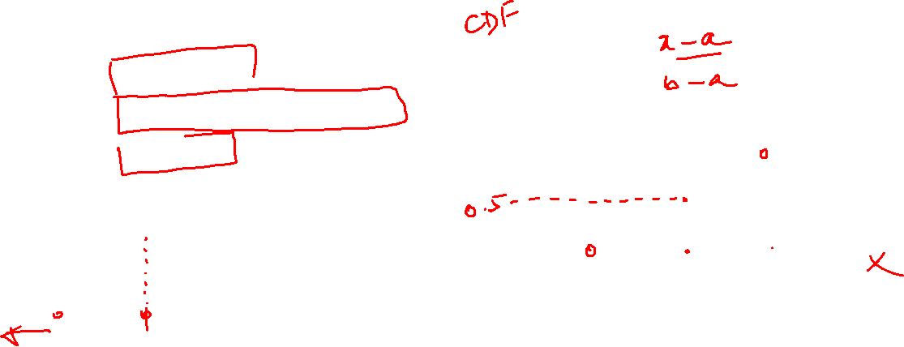
Cumulative Distribution Function (CDF)
The CDF of U(a,b) is:
F(x) = 0, x < a
(x-a)* 1/(b-a), a<= x <= b
1, x > b
f[x]
1
1 / (b-a)
x
a
b
a
b

Slide 19














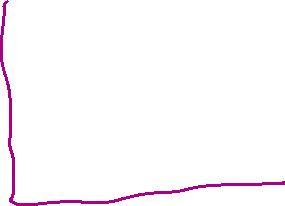
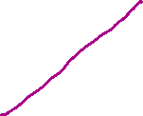



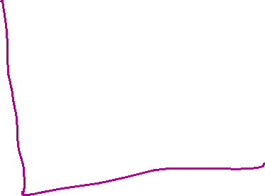

Slide 20
Find the following probabilities for this UD
P[X<c]
p[X>c]
P[X=c]
f[x]
1 / (b-a)
x
a
c
b

Slide 21
Find the following probabilities for this UD
P[X<c] = 1/(b-a) * (c – a)
p[X>c] = 1/(b-a) * (b – c)
P[X=c] = ?
f[x]
1 / (b-a)
x
a
c
b

Slide 22
P[X=c]
Given the infinite values possible in any interval of a Probability Distribution Function, the sliver which is “exactly equal to” is very thin
And the area of this sliver = 0
f[x]
1/(b-a)
x
a
c
b

Slide 23
Generalized form
Probability of x being >= x1 and <= x2
(x2-x1) * 1/(b-a)
f[x]
1 / (b-a)
x
a
x1
x2
b

Slide 24
Example: Bus Arrival Time
Given a bus has equal chance of reaching the stop within 30 min of scheduled time (assume uniform distribution)
What is the probability that the bus arrives within 10 min of scheduled time?
P[X < 10] = 1/(30-0) * 10 = 1/3
f[x]
1 / 30
x
0
10
30

Slide 25
Variation of the example
A bus service between stops A and B operates every 30 min i.e. a bus leaves from A to B every 30 min.
A passenger arrives at the stop A at a random time (without considering the bus schedule). So the next bus may be due anytime within the next 30 minutes. Assume Uniform Distribution.
Find the probability that a bus leaves within the next 10 minutes of passenger’s arrival.

Slide 26
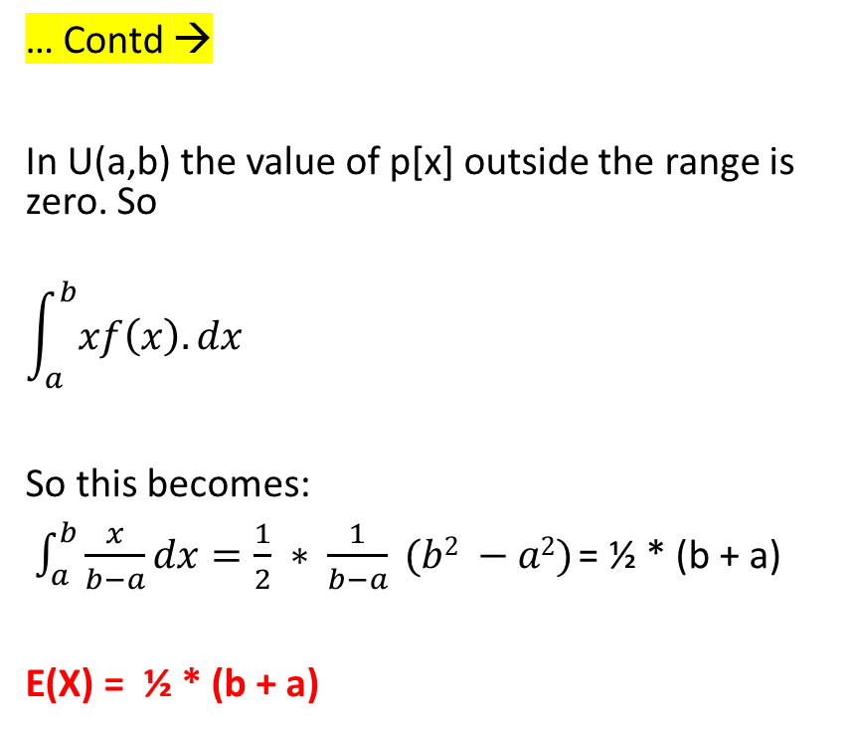
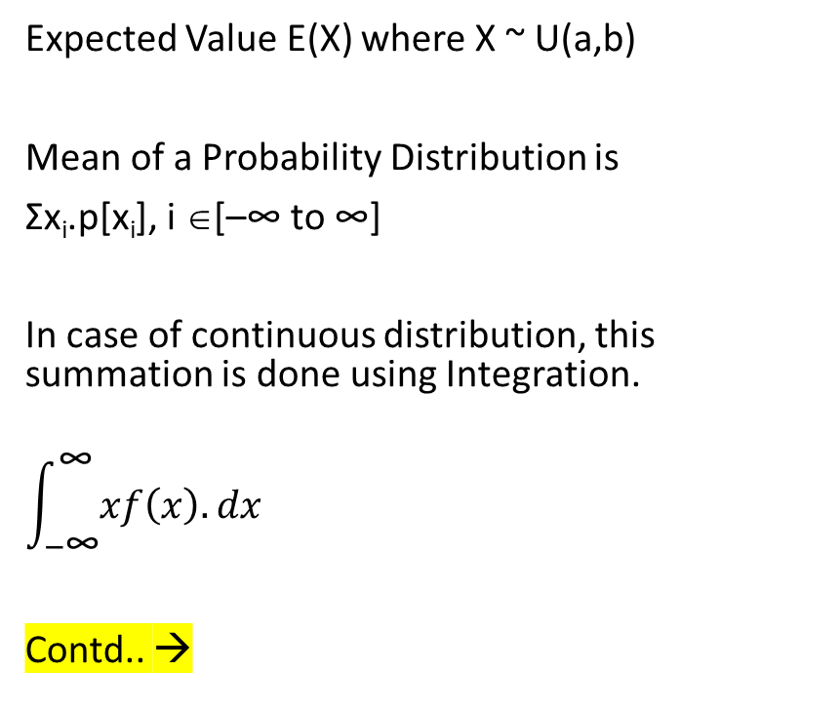
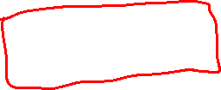
Mathematical Expectations
Expected Value E(X) where X ~ U(a,b)
Mean of a Probability Distribution is
Σx_{i}.p[x_{i}], i ∈[–∞ to ∞]
In case of continuous distribution, this summation is done using Integration.
$$\int_{−\text{∞}}^{\text{∞}}{xf\left(x\right).dx}$$
Contd.. →
… Contd →
In U(a,b) the value of p[x] outside the range is zero. So
$$\int_{a}^{b}{xf\left(x\right).dx }$$
So this becomes:
$\int_{a}^{b}{\frac{x}{b−a}dx=\frac{1}{2} ∗ \frac{1}{b−a} (b2 −a2) }$= ½ * (b + a)
E(X) = ½ * (b + a)

Slide 27
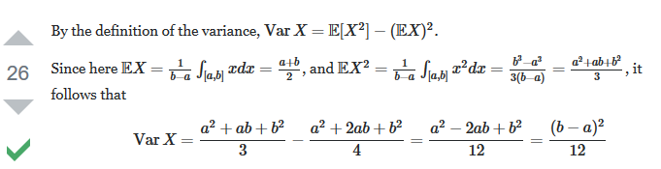
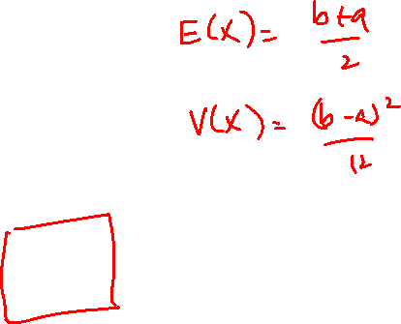
Variance of a Uniform Distribution
https://math.stackexchange.com/questions/728059/prove-variance-in-uniform-distribution-continuous

Slide 28
Following slide is optional
Variance has been derived from another way, not often seen online

Slide 29
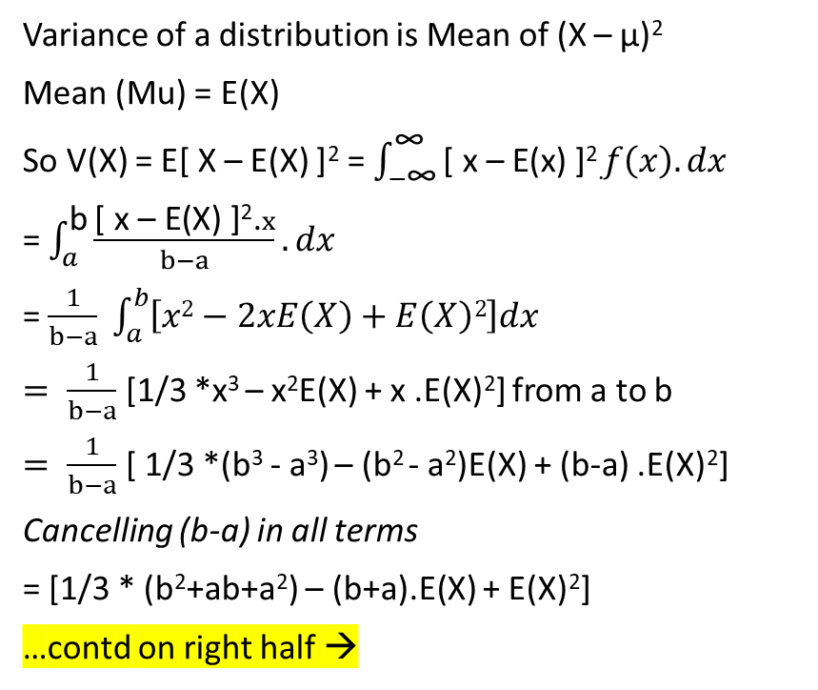
Mathematical Expectations
Variance of a distribution is Mean of (X – μ)²
Mean (Mu) = E(X)
So V(X) = E[ X – E(X) ]² = $\int_{−\text{∞}}^{\text{∞}}{\text{[ }\text{x}\text{ – }\text{E}\text{(}\text{x}\text{) ]}\text{2}\text{.}f\left(x\right).dx }$
= $\int_{a}^{\text{b}}{\frac{\text{[ }\text{x}\text{ – }\text{E}\text{(}\text{X}\text{) ]2.}x}{b−a}.dx }$
= $\frac{1}{b−a} \int_{a}^{b}{\left[x2−2xE\left(X\right)+E\left(X\right)2\right]dx}$
$= \frac{1}{b−a}$ [1/3 *x³ – x²E(X) + x .E(X)²] from a to b
$= \frac{1}{b−a}$ [ 1/3 *(b³ - a³) – (b² - a²)E(X) + (b-a) .E(X)²]
Cancelling (b-a) in all terms
= [1/3 * (b²+ab+a²) – (b+a).E(X) + E(X)²]
…contd on right half →
→ …contd
Substituting E(X) = ½ * (b+a):
= 1/3*(b²+ab+a²) – ½*(b+a)² + ¼ *(b+a)²
= 1/3*(b²+ab+a²) - ¼ *(b+a)²
= 1/12 * (4b² + 4ab + 4a² – 3b² – 3a² – 6ab)
= 1/12 * (b-a)²
So V(X) = 1/12 * (b-a)²

Slide 30
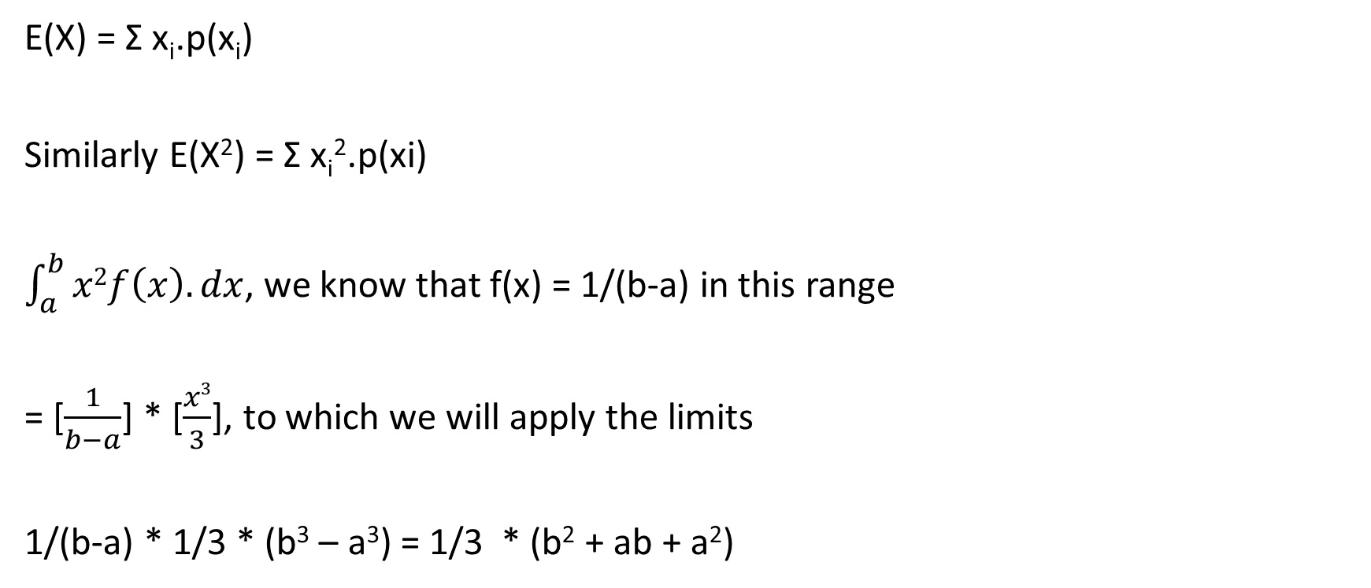
Expectation of X² i.e. E(X²)
E(X) = Σ x_{i}.p(x_{i})
Similarly E(X²) = Σ x_{i}².p(xi)
$\int_{a}^{b}{x2f\left(x\right).dx}$, we know that f(x) = 1/(b-a) in this range
= [$\frac{1}{b−a}$] * [$\frac{x3}{3}$], to which we will apply the limits
1/(b-a) * 1/3 * (b³ – a³) = 1/3 * (b² + ab + a²)

Slide 31
Examples
What is the Interquartile Range of UDF?
f[x]
Q1 – a
----------- = 0.25, so Q1 = a + (b-a)*0.25
b – a
Q3 – a
----------- = 0.75, so Q3 = a + (b-a)*0.75
b – a
1 / (b-a)
x
a
b
Qtrl1
Qtrl3

Slide 32
What about Mode of U(a,b)

Slide 33
Given a X~U(200,500) find the probability of X taking values in the range [100,300]

Slide 34






Given a X~U(200,500) find the probability of X taking values in the range [100,300]

Slide 35
Examples
f[x]
1 / (500-200)
Given a X~U(200,500) find the probability of X taking values in the range [100,300]
It is effectively p[200 to 300]
(300-200)/(500-200)
Given a X~U(0,100), what does the range x in [5,95] signify?
This range represents 90% of the area under the curve
Nothing more here but in subsequent topics this pattern will be useful
200
500
100
300
f[x]
1 / (b-a)
90%
0
100
5
95

Slide 36
Example
A coffee vending machine is set to stop anywhere between 180 to 190 ml
What is the probability it vends more than 185?
What is the probability it vends 182?

Slide 37
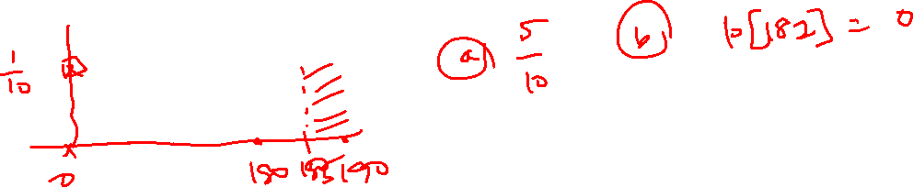
Example
A coffee vending machine is set to stop anywhere between 180 to 190 ml
What is the probability it vends more than 185?
What is the probability it vends 182?

Slide 38
Key concepts in Continuous Distributions
For any X=x, the probability is zero or greater
The PDF gives density at that point and not the probability at X=x
Area under a range is what gives the probability
Sum of area under a PDF = 1
Mean, Median, Mode of Continuous Distribution can take decimal values
There can be more than one Mode

Slide 39
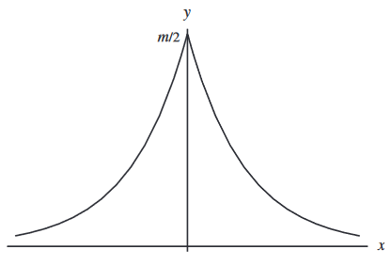
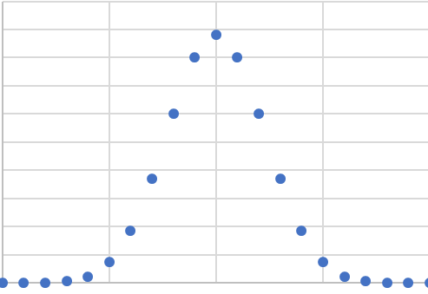
Searching for that distribution…
Simpson’s Error Curves
Laplace’s Error Curve
Binomial for high n
The Evolution of the Normal Distribution
https://www.maa.org/sites/default/files/pdf/upload_library/22/Allendoerfer/stahl96.pdf

Slide 40
Normal Distribution
Bell Curve
Symmetrical
Heaped at mean, decays as x moves away from the mean

Slide 41
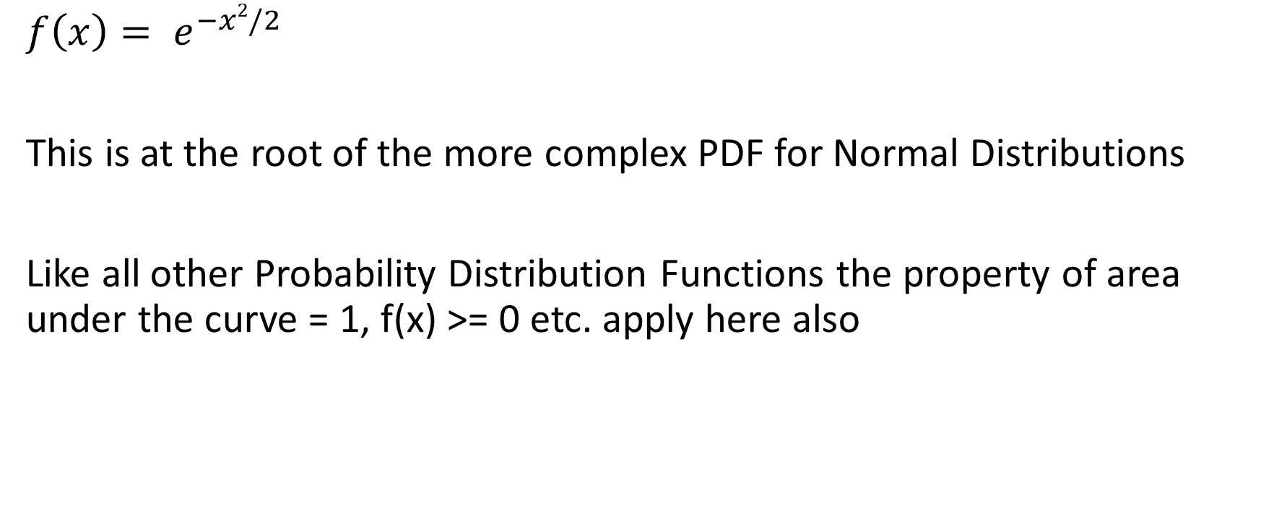
Step towards the Gaussian
$${f\left(x\right)= e}^{−x2/2}$$
This is at the root of the more complex PDF for Normal Distributions
Like all other Probability Distribution Functions the property of area under the curve = 1, f(x) >= 0 etc. apply here also

Slide 42




















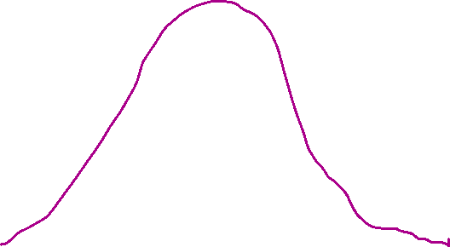



Slide 43




















Slide 44





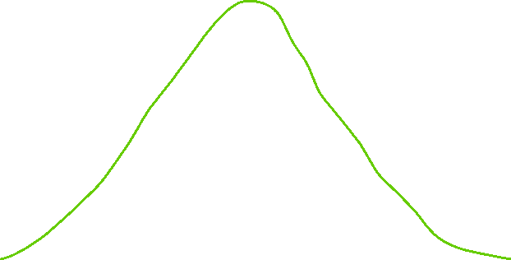






Slide 45







Slide 46
Use of Z score
Compare marks across batches i.e. compare data across populations
Solve problems about a single population by using Std Normal Distribution

Slide 47



Solve using Python
Z | Left area | Right area
-1.215
 | 0.05
2.34
 |  | 0.1
1.96
 |  | 0.05
Give | Get
stats.norm.cdf(z) | Area to left
stats.norm.sf(z) | Area to right
stats.norm.ppf(left area) | Z value
stats.norm..isf(right area) | Z value

Slide 48


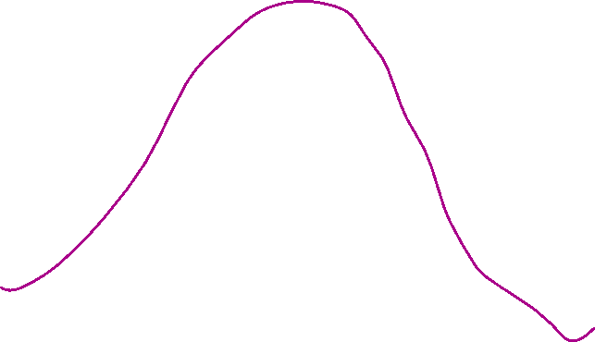
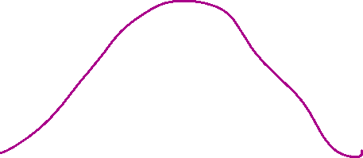




Slide 49
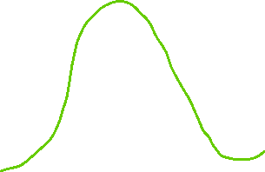

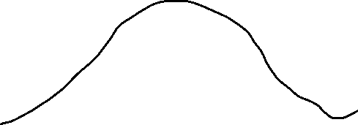



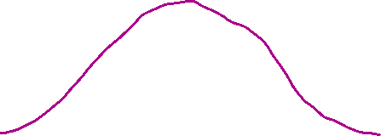





Slide 50



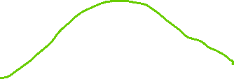



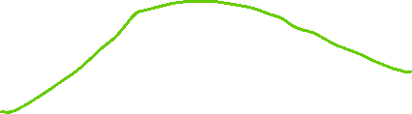

[1] Which student has done better?
Marks of 23 in a quiz where Mu was 31 and Sigma of 7 or
Marks of 17 in a quiz where Mu was 13 and sigma was 4

Slide 51









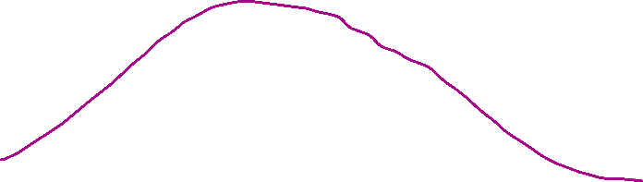

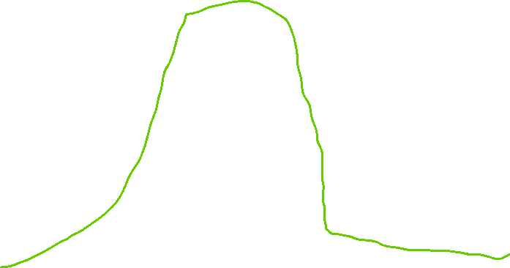





Slide 52
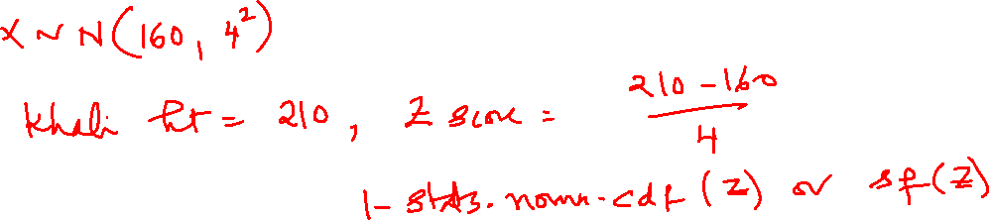
[2] Indian adult male have height of 160 cm average and sigma of 4. The WWF star Khali is 210 cm. What is the probability of another Indian male with matching or greater height?

Slide 53

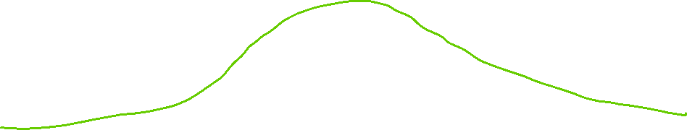

Slide 54





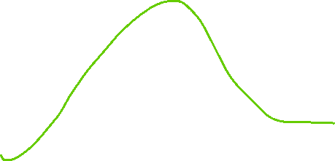





Slide 55
